Slide 1

CS-3002: Information Security
Lecture # 11: Network Security Protocols and Defensive Mechanisms (Firewall, IDS)
Department of Software Engineering
FAST-NUCES

Slide 2
This Lecture
Firewall
Intrusion Detection System (IDS)
DNSSEC
Distributed Denial Of Service (DDoS)

Slide 3
Firewall

Slide 4
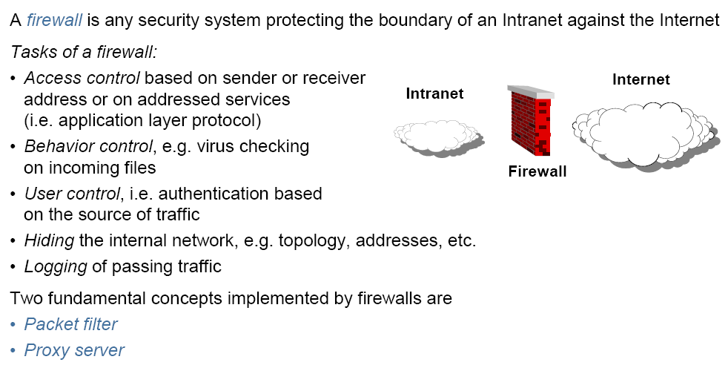
Firewall

Slide 5
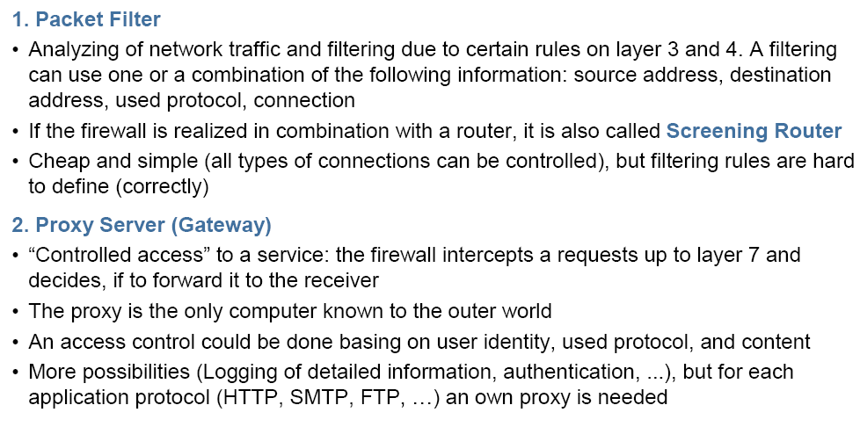
Types of Firewalls
Notes:
Firewall can also be a software at your PC. In Linux you can also define rules on IP Tables.

Slide 6
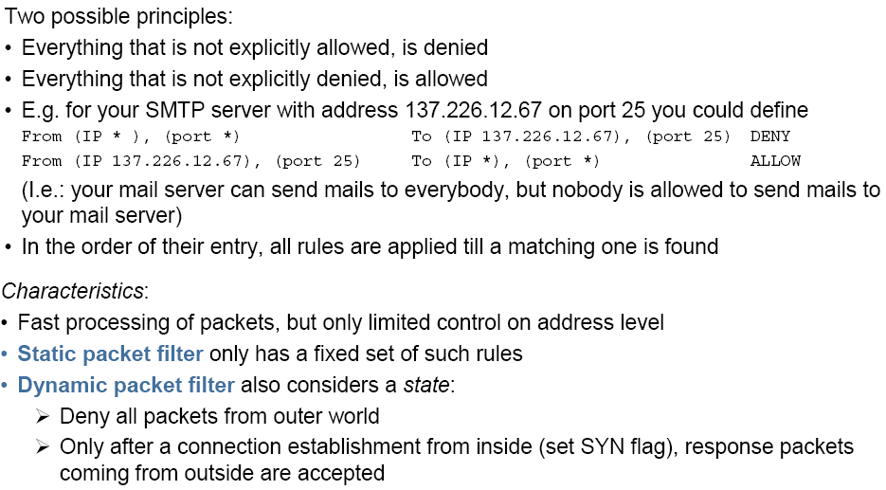
Packet Filter
Notes:
In computing, a stateful firewall (any firewall that performs stateful packet inspection (SPI) or stateful inspection) is a firewall that keeps track of the state of network connections (such as TCP streams,UDP communication) traveling across it. The firewall is programmed to distinguish legitimate packets for different types of connections. Only packets matching a known active connection will be allowed by the firewall; others will be rejected.

Slide 7
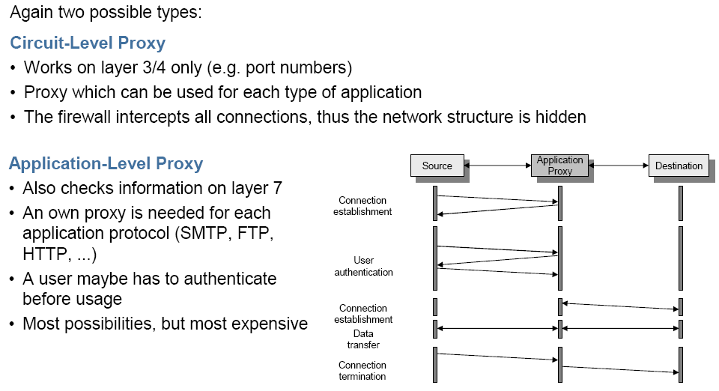
Proxy Server

Slide 8
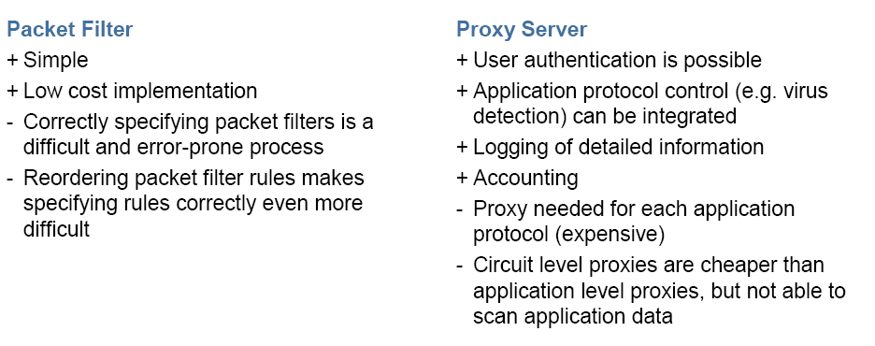
Packet Filter vs Proxy Server

Slide 9
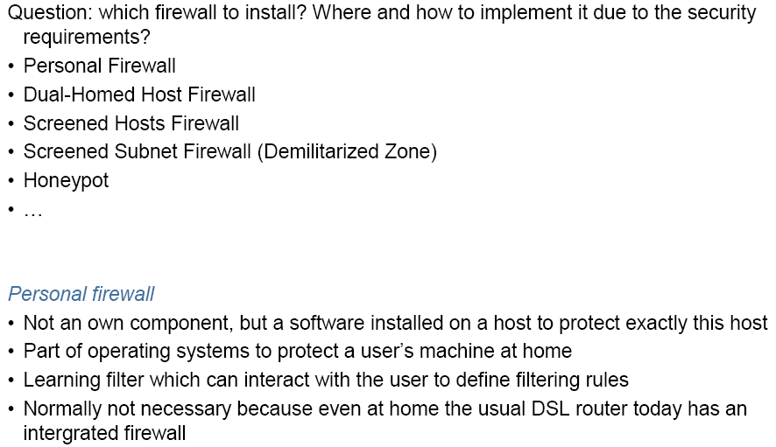
Security Architectures

Slide 10
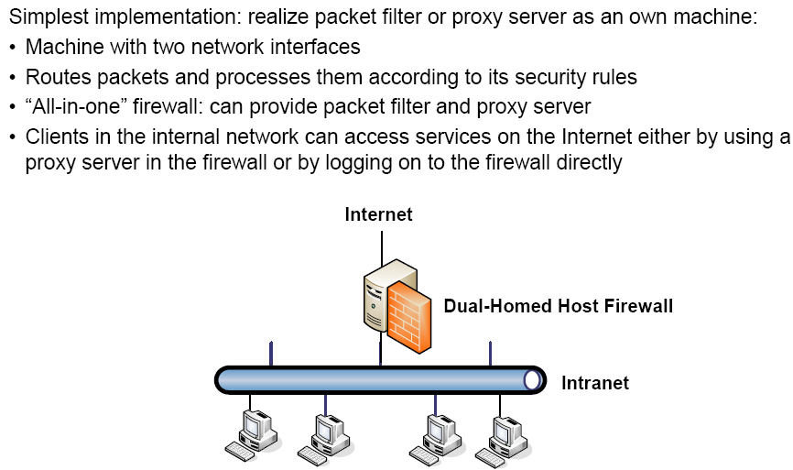
Dual-Homed Host Firewall
Notes:
A dual-homed host (or dual-homed gateway^{[1]}) is a system fitted with two network interfaces (NICs) that sits between an untrusted network (like the Internet) and trusted network (such as a corporate network) to provide secure access. Dual-homed is a general term for proxies, gateways, firewalls, or any server that provides secured applications or services directly to an untrusted network.

Slide 11
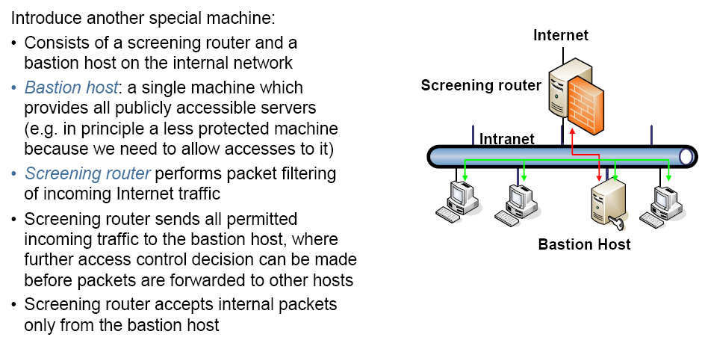
Screened Hosts Firewall

Slide 12
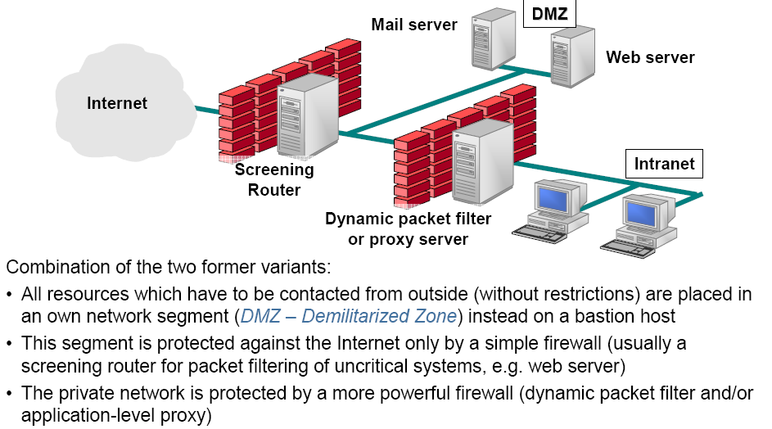
Demilitarized Zone

Slide 13
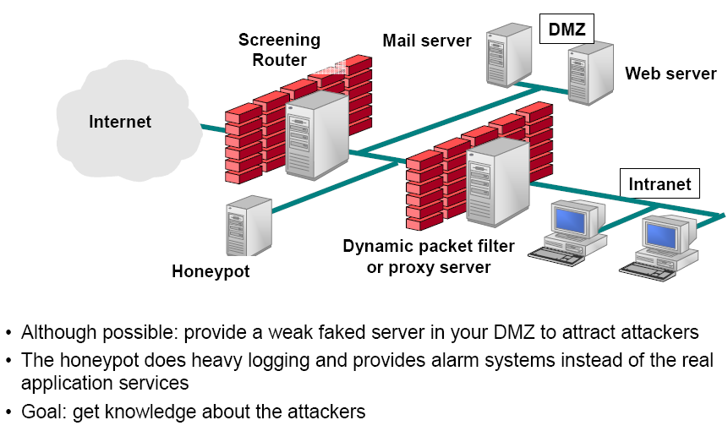
Additional: Honeypot

Slide 14
Intrusion Detection

Slide 15
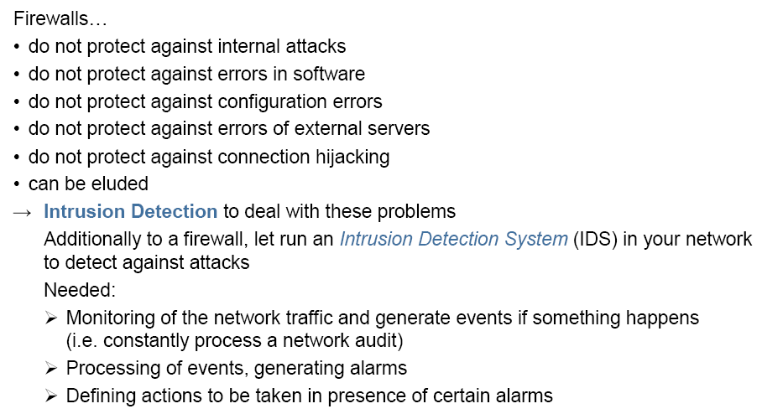
Intrusion Detection

Slide 16
Intrusion detection
Many intrusion detection systems
Close to 100 systems with current web pages
Network-based, host-based, or combination
Two basic models
Misuse detection model
Maintain data on known attacks
Look for activity with corresponding signatures
Anomaly detection model
Try to figure out what is “normal”
Report anomalous behavior
Fundamental problem: too many false alarms

Slide 17
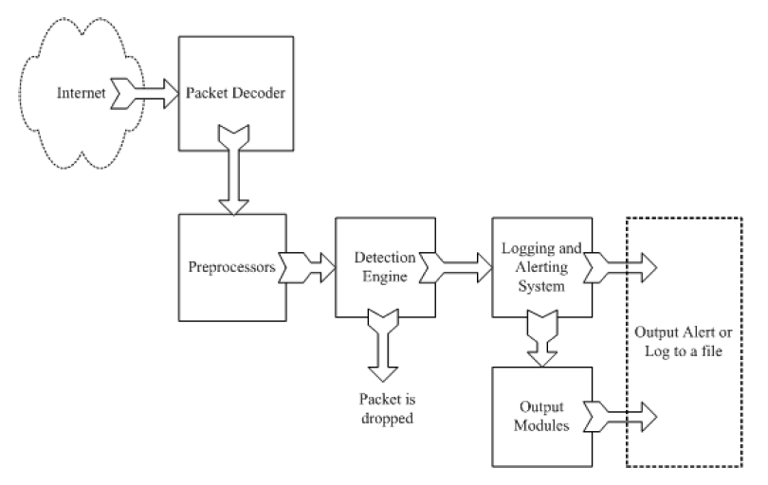
Example: Snort
http://www.snort.org/
From: Rafeeq Ur Rehman, Intrusion Detection Systems with Snort: Advanced IDS Techniques with Snort, Apache, MySQL, PHP, and ACID.

Slide 18
Snort components
Packet Decoder
input from Ethernet, SLIP, PPP…
Preprocessor:
detect anomalies in packet headers
packet defragmentation
decode HTTP URI
reassemble TCP streams
Detection Engine: applies rules to packets
Logging and Alerting System
Output Modules: alerts, log, other output

Slide 19
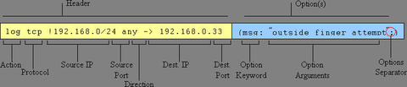
Snort detection rules
rule header
rule options

Slide 20
Snort challenges
Misuse detection – avoid known intrusions
Database size continues to grow
Snort version 2.3.2 had 2,600 rules
Snort spends 80% of time doing string match
Anomaly detection – identify new attacks
Probability of detection is low

Slide 21
Difficulties in anomaly detection
Lack of training data
Lots of “normal” network, system call data
Little data containing realistic attacks, anomalies
Data drift
Statistical methods detect changes in behavior
Attacker can attack gradually and incrementally
Main characteristics not well understood
By many measures, attack may be within bounds of “normal” range of activities
False identifications are very costly
Sys Admin spend many hours examining evidence

